Slide 1
Seismic Bumps Hazard Prediction
Predicting hazardous high-energy events in Polish coal mines with machine learning
EDA · Imbalanced classification · Energy regression
Notes:
Project overview: UCI Seismic-bumps dataset, two tasks: classify hazardous shifts and regress bump energy.

Slide 2
The Problem & the Data
Each row = one 8-hour shift; goal = predict a hazardous bump (>10⁴ J) in the NEXT shift
2,584
18
6.58%
0
shifts (rows)
input features
hazardous (170 shifts)
missing / duplicate
Task 1 – Classification: predict class (0 safe / 1 hazardous)
Task 2 – Regression: predict total bump energy per shift
Challenge: an "always safe" model scores 93% accuracy but is useless, so recall, F1 and ROC-AUC on the hazardous class are what matter
Notes:
Stress the imbalance: accuracy is misleading here.

Slide 3
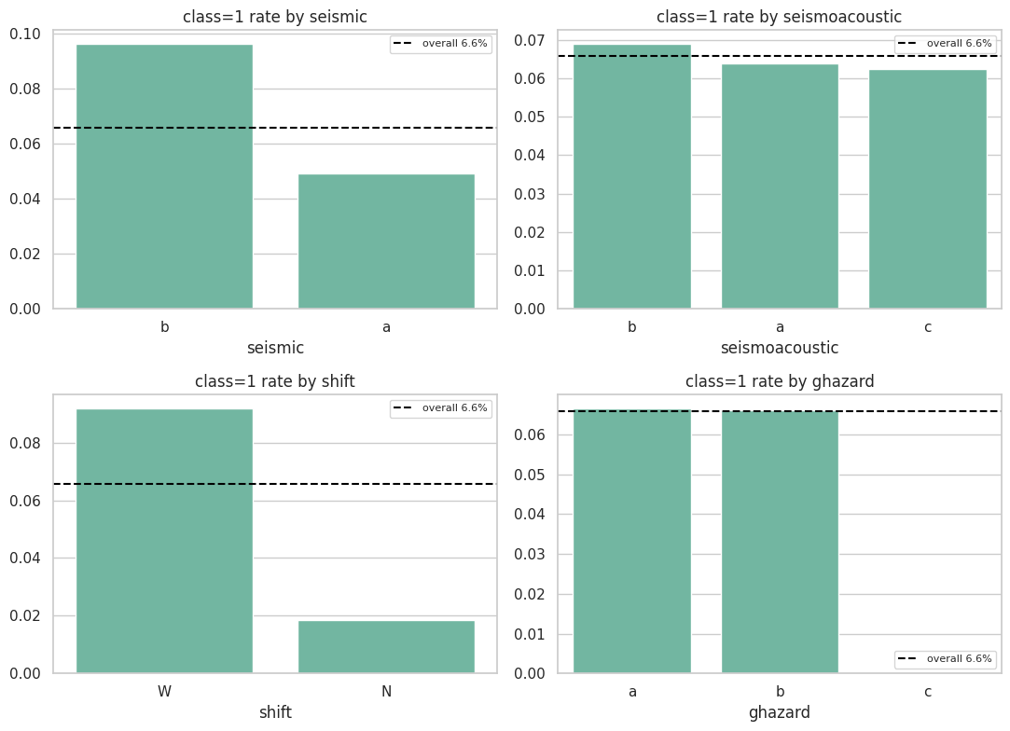
What the EDA Revealed
Shift type and bump counts carry the signal; deviation features carry almost none
Production shifts (W): 9.2% hazardous vs 1.8% for preparation (N), a 5× gap
seismic = b: 9.6% vs 4.9% for a
nbumps outliers: 22.4% hazardous vs 4.7% normal; genergy outliers 17.8% vs 5.9%
nbumps has the top numeric correlation with the target (0.25)
gdenergy / gdpuls ≈ 0 correlation; nbumps6/7/89 are all zeros
Notes:
Barplots show class=1 rate per category against the 6.6% base rate.

Slide 4
Preprocessing Pipeline
Leakage-aware: split first, then fit scaler and SMOTE on training data only
1
Feature engineering 12 new features (bump ratios, energy per pulse, deviation magnitude, hazard agreement)
2
Outliers log1p on 7 right-skewed columns (genergy mean/median 90,243/25,485 → 10.22/10.15)
3
Encoding & clean-up Ordinal for hazard columns, one-hot for shift; 4 all-zero columns dropped → 26 features
4
Split & scale Stratified 80/20, seed 42: 2,067 train / 517 test; StandardScaler on train
5
SMOTE Train only: 1,931 : 136 → 1,931 : 1,931; test set untouched
Notes:
Order matters: scaling and SMOTE are fit after the split to avoid leakage. Constant columns nbumps6, nbumps7, nbumps89, has_high_energy_bump were dropped.

Slide 5
Classification: The Accuracy Paradox
Baseline models at threshold 0.5 on 517 test shifts (34 hazardous)
Logistic Regression: ROC-AUC 0.7651, recall 0.62, catches ~21 of 34 hazardous shifts
Random Forest: ROC-AUC 0.7245, recall 0.18
XGBoost: ROC-AUC 0.7414, recall 0.15
Tree models look good on accuracy yet miss more than 80% of hazards
Tuned RF (RandomizedSearchCV, F1) gives recall 0.15 at 0.5, so tune the threshold
Notes:
High accuracy from RF and XGBoost is driven by the majority class.

Slide 6
Threshold Tuning with Cross-Validation
Threshold chosen on training data (5-fold CV, best F1); test set used once at the end
Model (test set) | Threshold | Precision | Recall | F1
Logistic Reg., default | 0.5 | 0.16 | 0.62 | 0.25
Logistic Reg., CV-chosen | 0.7 | 0.26 | 0.41 | 0.32
Tuned RF, default | 0.5 | 0.21 | 0.15 | 0.17
Tuned RF, CV-chosen | 0.2 | 0.17 | 0.56 | 0.26
Highlighted rows use the threshold picked by cross-validation, so the test result is not tuned on the test set
Logistic Regression gets the best F1 (0.32) and ROC-AUC (0.7651); tuned RF at 0.2 catches more hazards (recall 0.56) with more false alarms
The threshold is a business decision: missed hazards vs false alarms
Notes:
CV thresholds: LR 0.7, RF 0.2. Test set has only 34 hazardous shifts, so numbers are noisy.

Slide 7
Energy Regression & Takeaways
maxenergy leaked the target (R² ≈ 0.99) and was removed; id and class excluded
Accuracy is the wrong metric for a 6.6% positive class
Logistic Regression is the strongest baseline; thresholds tuned with CV lift its F1 to 0.32
Shift type, nbumps and genergy are the key signals
Caveat: nbumps4 and nbumps5 hold ~86% of the importance and set energy almost by definition, so R² is an upper bound
Next: PR-AUC, SMOTE inside the tuning CV, more hazardous samples
Linear Regression: RMSE 6498, MAE 1951 · Random Forest: best MAE 1844
Notes:
Caveats: only 34 positives in the test set, so treat numbers as approximate.

